Slide 1

Telegram Threats & Cybercrime
A Law Enforcement Perspective for Kerala Police

Slide 2

Introduction to Telegram Threats
Presented to: Kerala Police
Date: 05.07.2025
Presenter: [AHAMED IRFAN M/ VLBJCAS]

Slide 3
Agenda Overview
1
Telegram Overview
Understanding the platform's features.
2
Cybercrime on Telegram
Why criminals favour this platform.
3
Compromising Methods
How Telegram becomes a tool for crime.
4
Real-World Cases
Illustrative examples of Telegram-based crimes.
5
Investigative Tools
Resources for law enforcement.
6
Action Plan
Strategies for combating Telegram cybercrime.
7
Q&A Session
Addressing your questions.

Slide 4
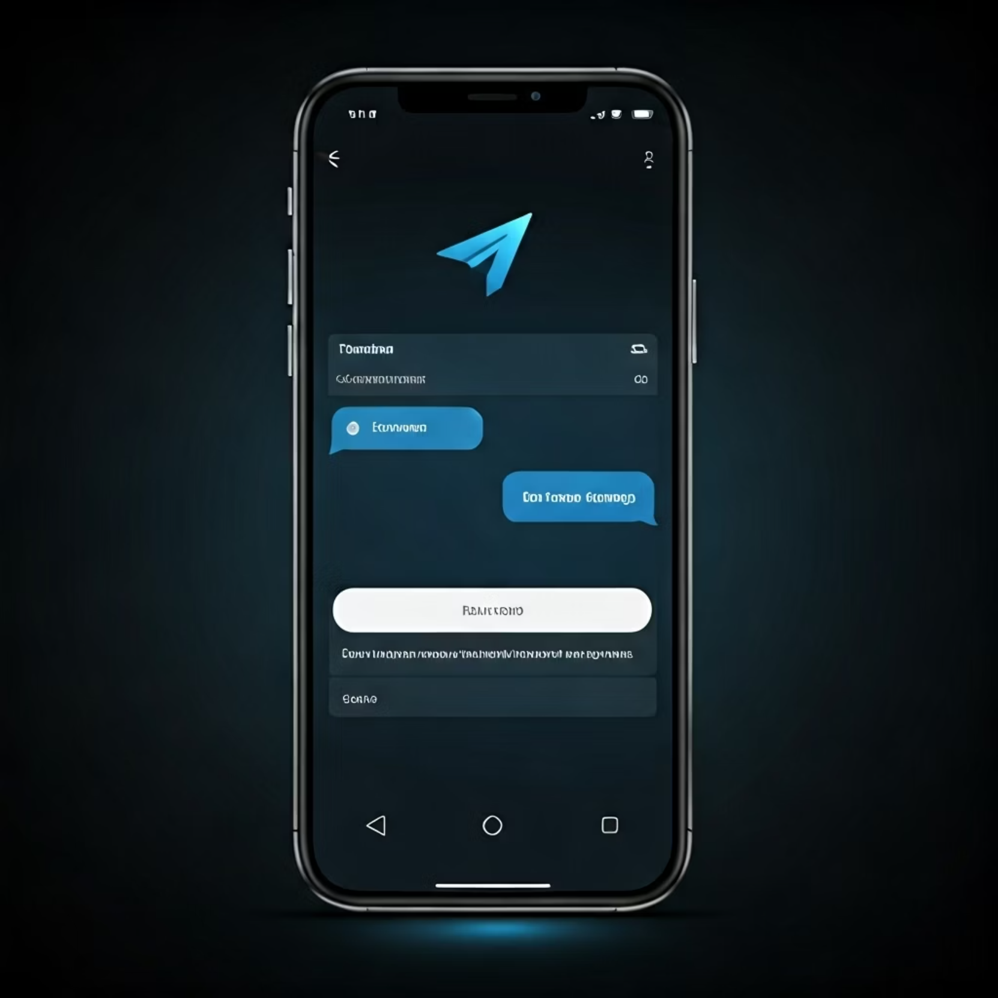
What is Telegram?
Encrypted messaging app
900+ million users globally
Large groups, secret chats, bots, file sharing
Cross-platform accessibility
Minimal identity verification

Slide 5
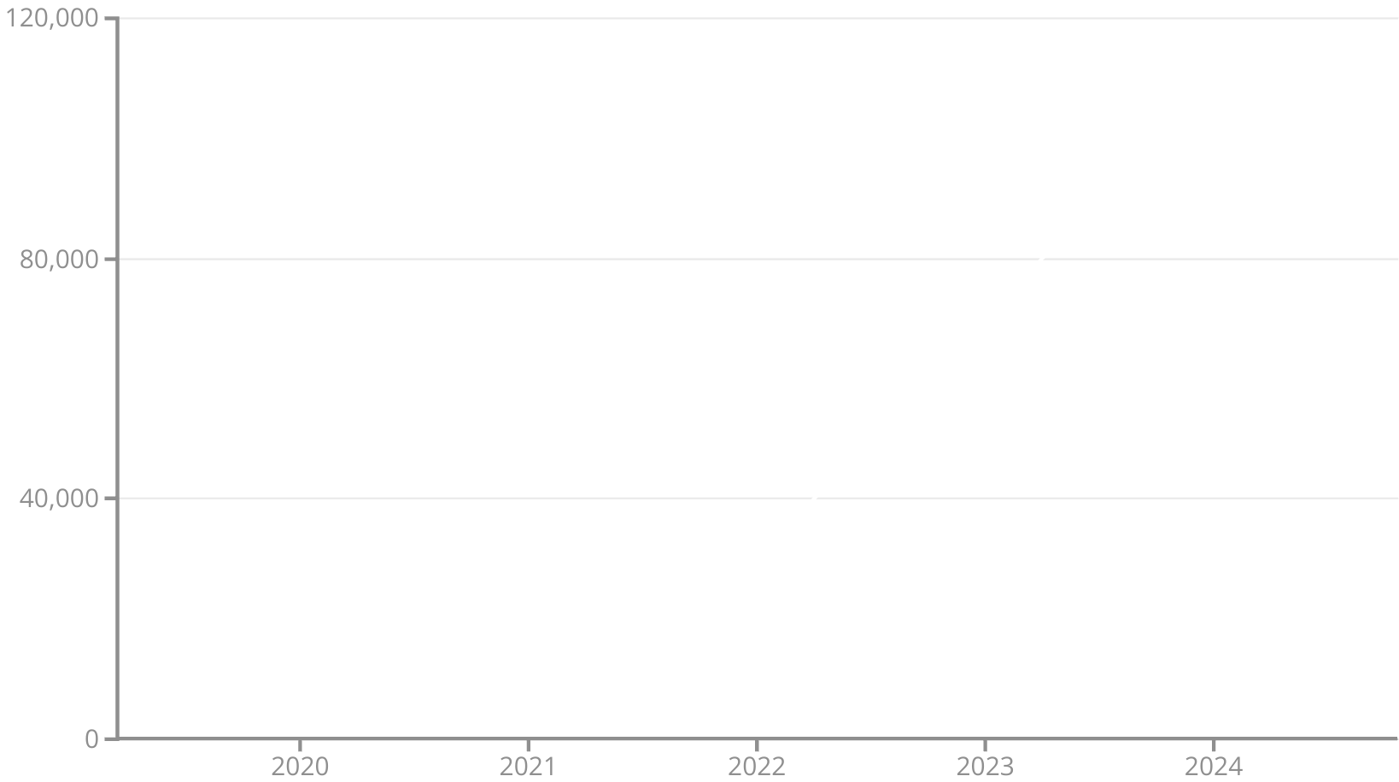
Why Cybercriminals Use
Telegram
High anonymity features
Lack of strong content moderation
Automation via sophisticated bots
Easy creation of large channels (thousands of users)
Rise in Cybercrime Posts on Telegram

Slide 6





Types of Cybercrime on Telegram
Phishing & Malware
Job & Investment Scams
Kits and delivery of malicious software.
Prepaid task scams, fake opportunities.
Terrorist Propaganda
Stolen Data Marketplaces
Recruitment and coordination (Terrorgram).
Selling carding data, SSNs, credentials.

Slide 7

Real-World Cases
Telekopye Bot: Automated phishing toolkit.
India: Crores lost in Telegram-based job scams.
Global: Terror groups use for recruitment, planning.
Kerala: Specific instances of local impact.

Slide 8

Telegram Compromise
Methods
Phishing Bots
Automated generation of fraudulent websites.
Card Skimmers
Malware sends stolen data via Telegram.
Social Engineering
SMS code theft, credential harvesting.
DoS Coordination
Channels used to orchestrate attacks.

Slide 9
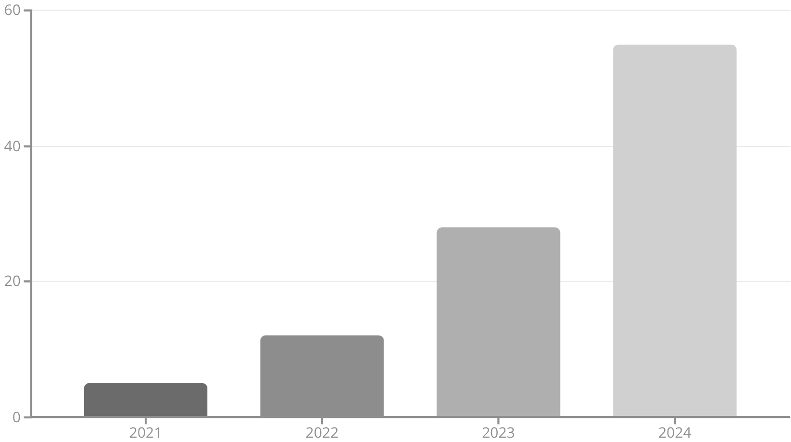
Impact and Scale of Threats
Telegram-related cybercrime is escalating rapidly.
53% rise in 2024
Thousands of fraud groups hosted
Billions lost globally from scams
Kerala facing significant financial losses
Growth in Fraudulent Telegram Channels (2021-2024)

Slide 10

Law Enforcement Challenges
Unique obstacles in combating Telegram-based cybercrime:
End-to-End Encryption
Secures communications, hinders interception.
Anonymous Hosting
Cloud-based infrastructure complicates tracing.
Limited Monitoring Tools
Lack of real-time surveillance capabilities.
Telegram's Cooperation
Challenges in obtaining data from the platform.

Slide 11

Combating Cybercrime in Kerala: A Strategic Approach to Telegram
Addressing the growing threat of cybercrime via Telegram. A proactive enforcement model for enhanced public safety and security.

Slide 12





Recommended Police Action Plan
Cybercell Telegram Monitoring Units
Dedicated units for real-time surveillance and intelligence gathering on Telegram channels.
Partnerships with OSINT Vendors
Leveraging Open-Source Intelligence tools and expertise for deeper insights into criminal networks.
Public Awareness Workshops
Educating citizens on common scams, fraud, and self-protection measures on digital platforms.
Legal SOPs for Takedown Requests
Standardised operating procedures for swift and legal removal of illicit content and channels.
Monitoring Local Groups
Targeted surveillance of regional Telegram groups to identify localised scams and fraudulent activities.

Slide 13

Conclusion: Towards a Safer Digital Kerala
Telegram: A Growing Cybercrime Frontier
Vigilance, Advanced Tooling, Inter-Agency Support
Kerala Police: A Model for Proactive Enforcement
The platform's features present unique challenges requiring continuous adaptation and advanced counter-measures.
Opportunity to establish a leading example in digital policing and safeguarding communities.
Key pillars for effective cybercrime combat: continuous monitoring, cutting-edge technology, and collaborative efforts.

Slide 14

Questions & Discussion
Your insights and collaboration are vital as we forge a path to a more secure digital future for Kerala.

